Slide 1
TEAM 3
Economic Activities in México: Profit and loss
1998 - 2019 vs. 2020
Gerardo Jiménez
Daniela Marroquín
Pilar Montes
Luis Alejandro Vera
Ilse Rangel
Karla Arzate
February 2021

Slide 2
Contents
Research Questions …………………………………………………….……………………………… | 3
Searching for the data …………………………………………………………………………………… | 4
Analysis Process ………..………………………………………………………………………………. | 5
Conclusions ……………………….. ………………………….………………………………………… | 6

Slide 3
Which activities were the most affected in 2020?
Which activities grew in 2020?
Research
Questions
Which activities had sustained
growth from 1998 to 2019 vs 2020?
Which trends were observed for 2021?

Slide 4
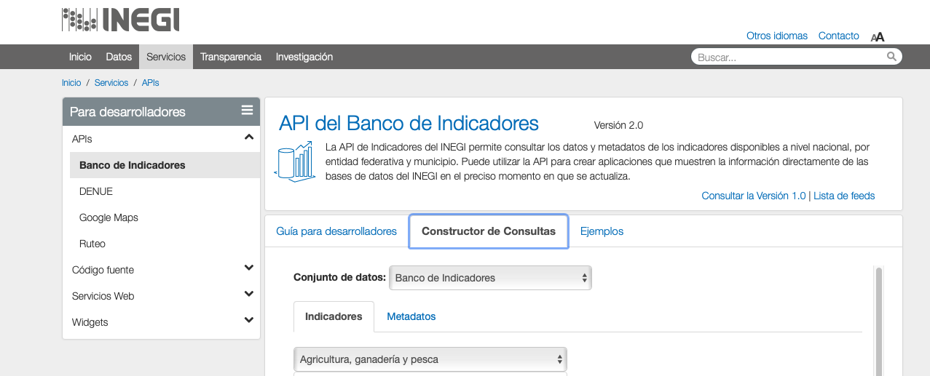
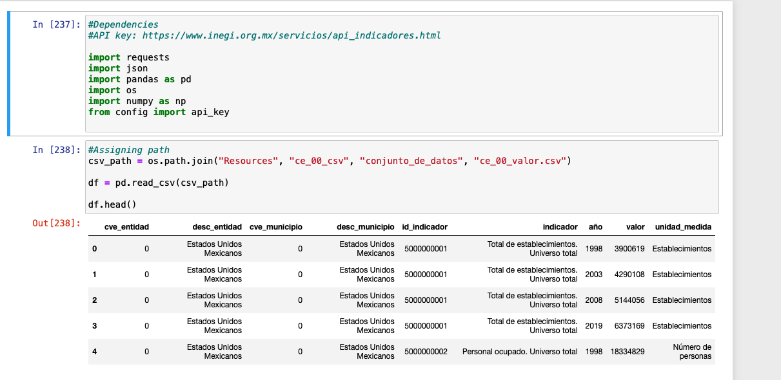
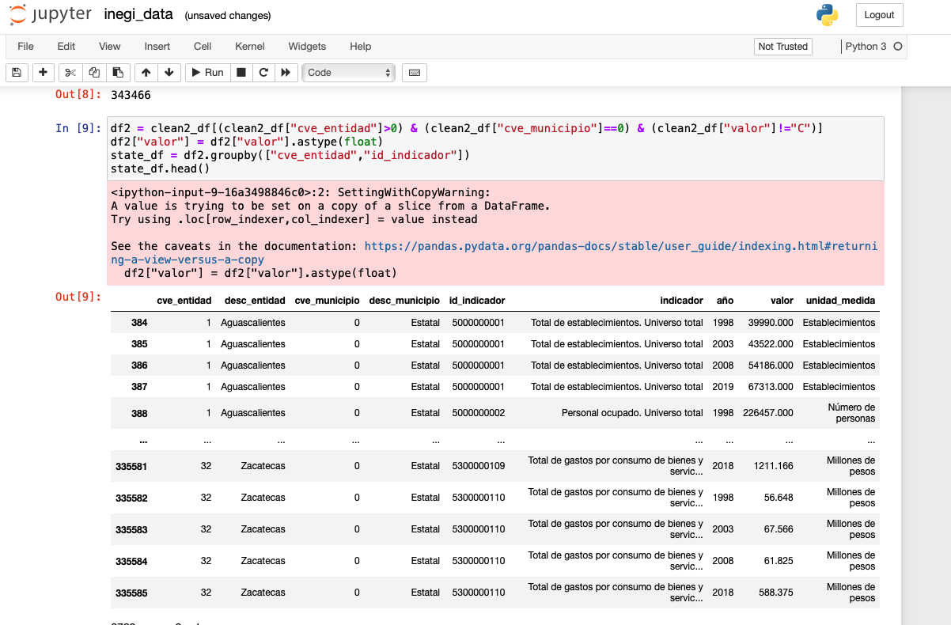
Searching for the data
1
INEGI API’s
2
INEGI CSV files
Searching for
the data
3
Exploration Process
4
Cleanup Process

Slide 5
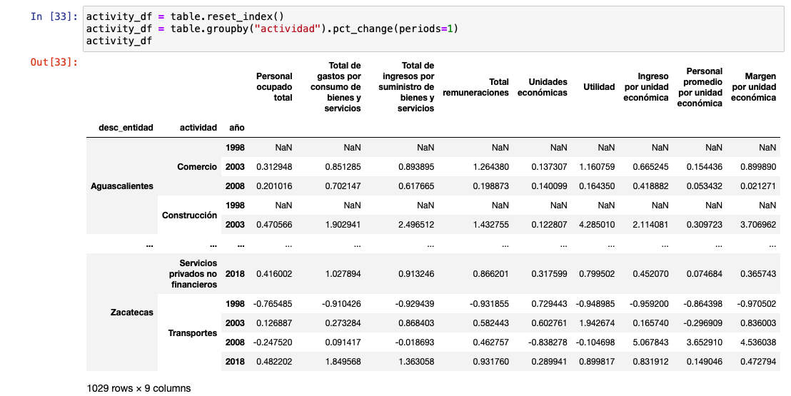
Analysis Process
E
Step
05
Make the conclusions
D
Step
04
Define economic zones and compare them
C
Step
03
Choose graphics to visualize the data
B
Step
02
Create the pivot tables with the variables needed to analyze
A
Step
01
Identify the 10 types of business to analyze and
define the variables needed to perform the analysis

Slide 6
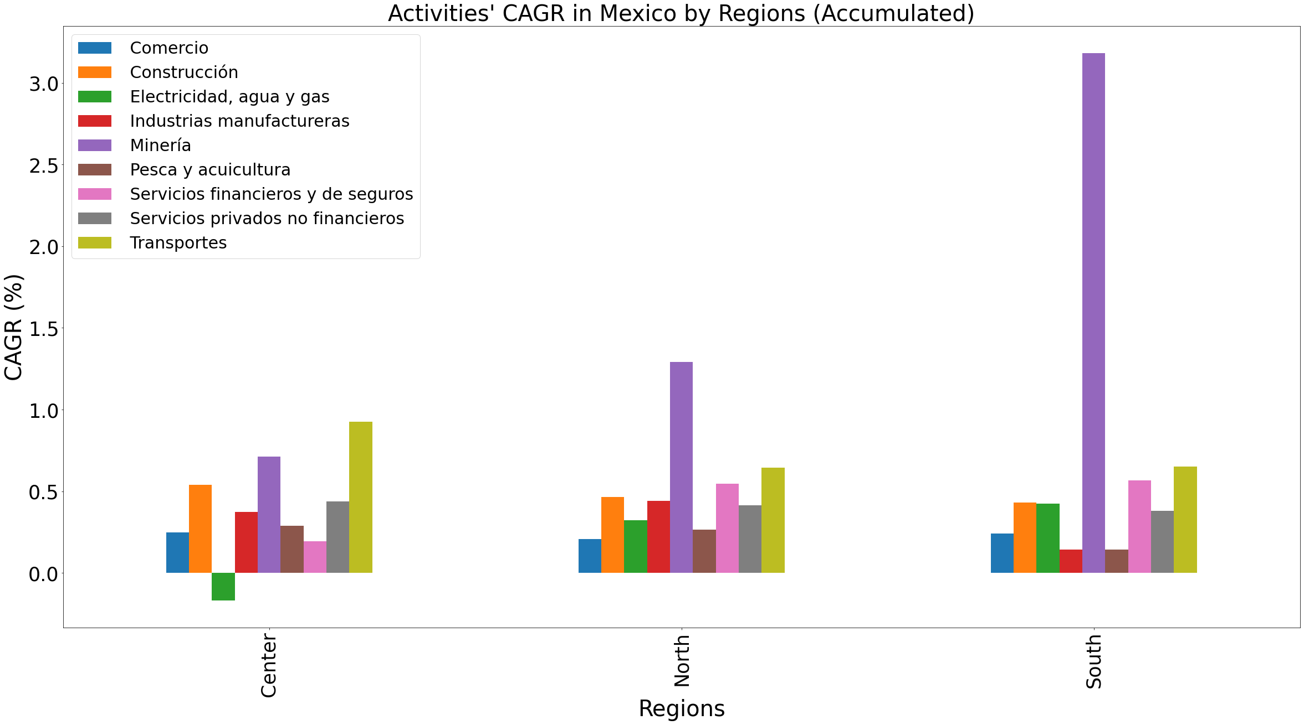
Conclusions
Economic Behavior 1998-2018 by Mexico’s Regions

Slide 7
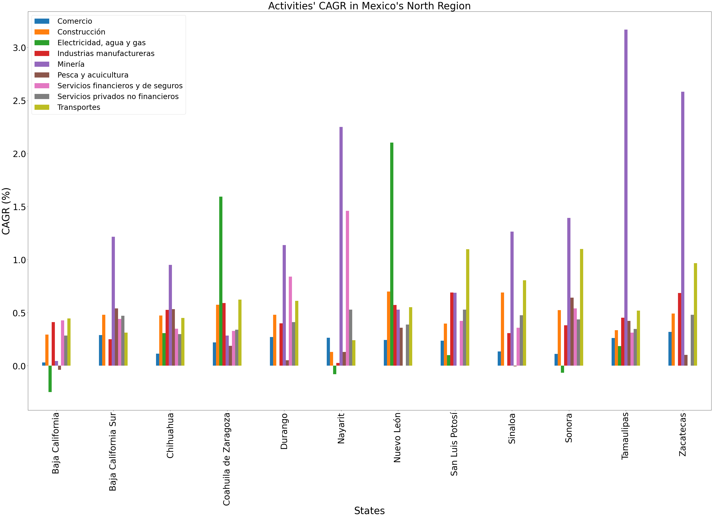
Conclusions
Top 3 Profit and Loss Activities in North Region (1998-2018)
1. Mining
2. Transportation
3. Manufacture industries
1. Fishing and aquaculture
2. Electricity, water & gas
3. Commerce

Slide 8
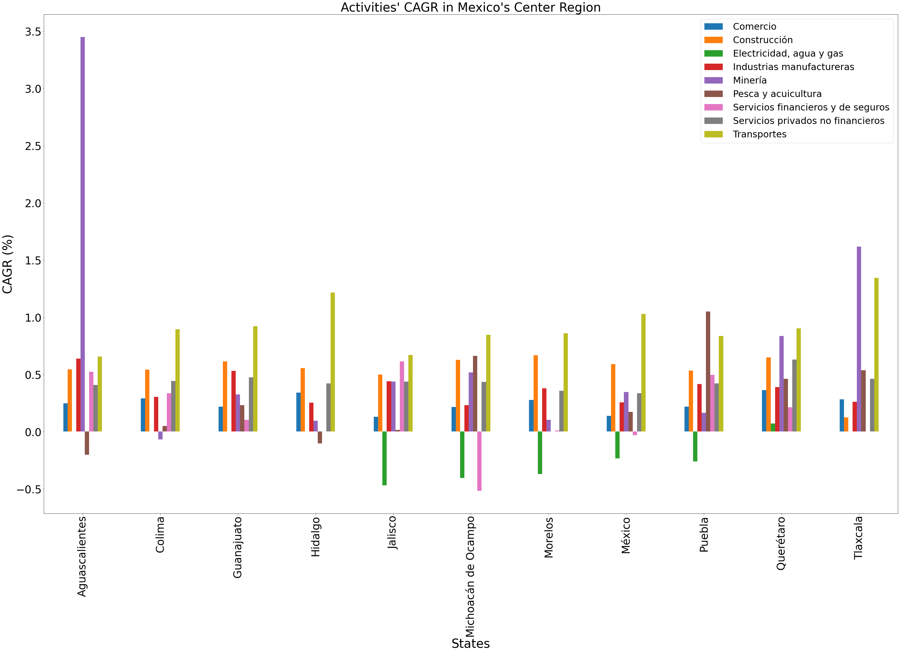
Conclusions
Top 3 Profit and Loss Activities in Center Region (1998-2018)
1. Transportation
2. Mining
3. Construction
1. Electricity, water & gas
2. Fishing & aquaculture
3. Financial services and insurance

Slide 9
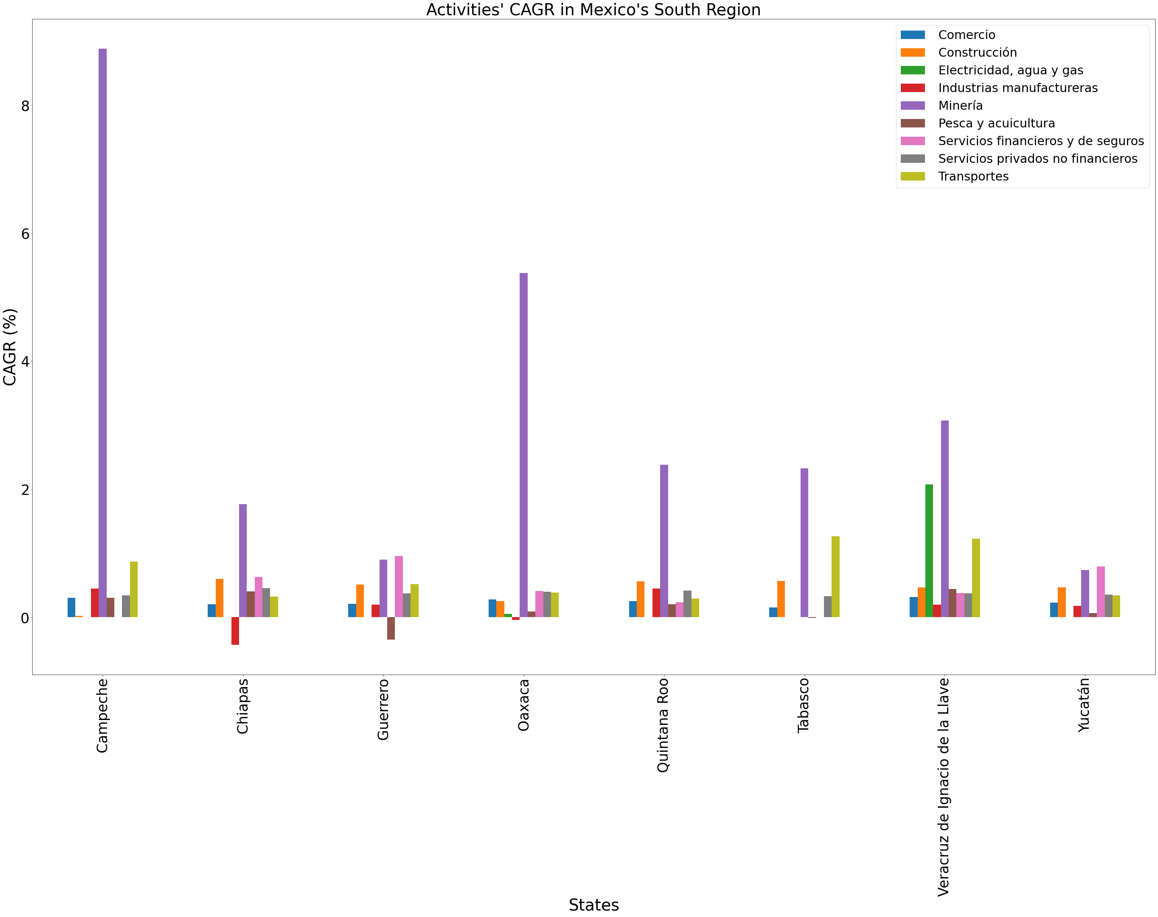
Conclusions
Top 3 Profit and Loss Activities in South Region (1998-2018)
1. Mining
2. Transportation
3. Financial services and insurance
1. Manufacture industries
2. Fishing & aquaculture
3. Electricity, water & gas

Slide 10
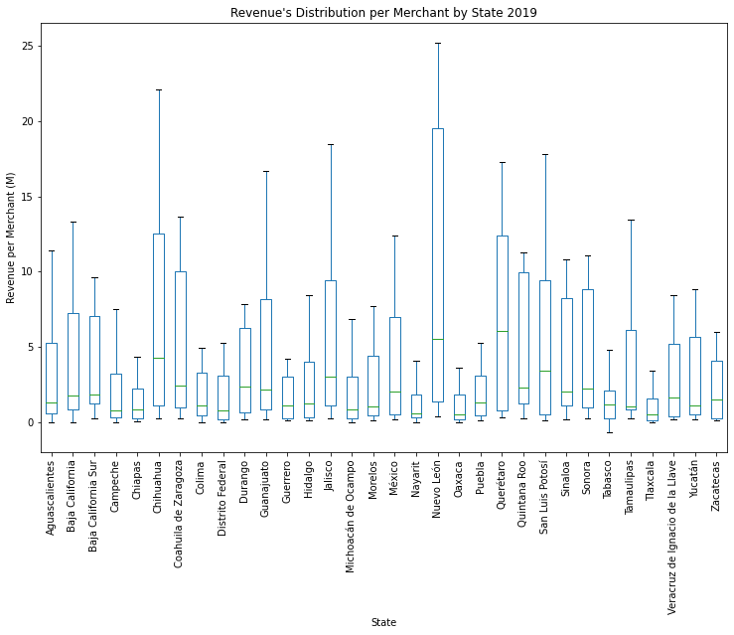
Conclusions
Revenues distribution by State (2019)
1
During 2019, Nuevo León, Chihuahua, Querétaro had the highest revenue per merchant among the 32 states of the country; also, these states had the greatest variation between the activities.
2
In contrast, during 2019, most of the states of Mexico’s South Region had the lowest revenue per merchant among the 32 states of the country; also, these states had the smallest variation between the activities.

Slide 11
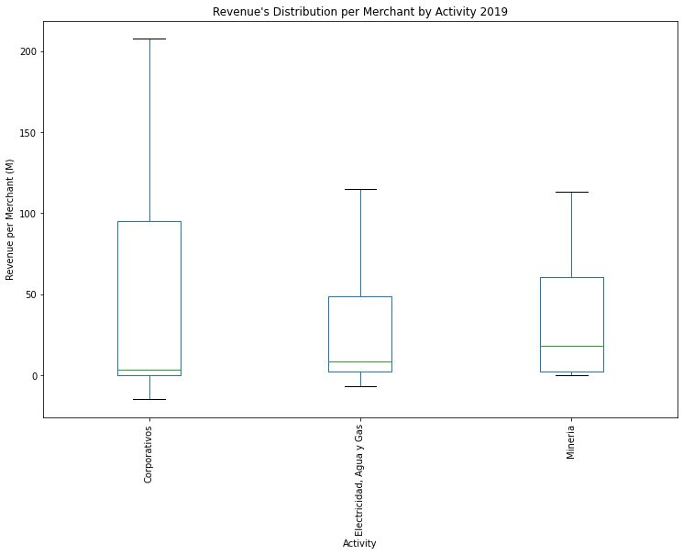
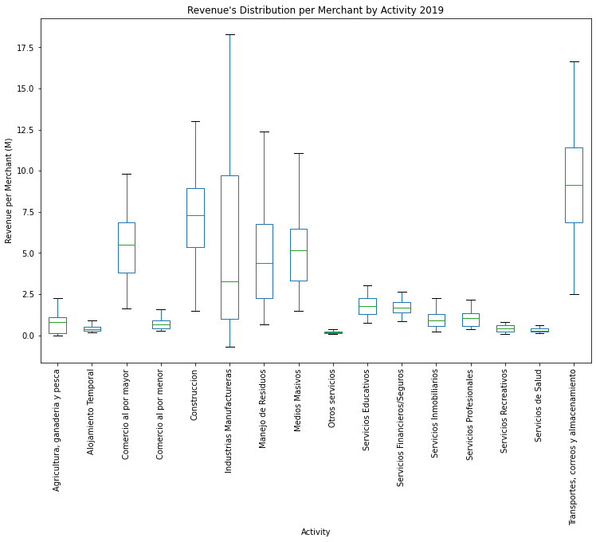
Conclusions
Revenues distribution by Activity (2019)

Slide 12
Conclusions
Revenues distribution by Activity (2019)
1
During 2019, corporate, mining and electricity, water and gas activities had the most revenues per merchant in its activities. Is important to mention, that mining and electricity, water and gas had similar behaviors.
2
For activities with revenues per merchant lower than 20 M, transportation and warehousing, and construction had the most revenues; while health services, amusement services, other services (i.e., maintenance and repair services, personal services and domestic services), retail trade and accommodation and food services had the lowest revenue distribution per merchant.

Slide 13
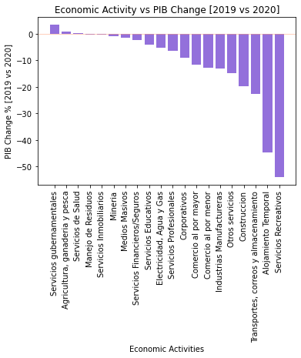
Conclusions
Economic Activity vs PIB Change
1
Due to the lack of data, We estimate the activities by 2020 PIB’s delta- According to the above, the activities that grew where government services, agriculture, cattle raising and fishing, and health services.
While activities like accommodation and food services , and amusement services presented the greatest loss among all the activities.

Slide 14
Conclusions
With all the information above, we noticed that the growth trends that were identified thru 1998 to 2018 for activities like mining, transportation and construction had a negative feedback for 2020 due to the COVID-19 Pandemic. As seen in the previous graph, the only activities that had a positive result where government services, primary activities such as agriculture, cattle raising and fishing, as well as health services.
In order to revert this trend for 2021, it’s important that the companies that belong to the activities that presented negative trends change and innovate the way they have been conducting business.

